Slide 1
COMP 2230
Week 5 - Wednesday

Slide 2
Last time
Exam 1 post mortem
Induction example

Slide 3
Questions?

Slide 4
Assignment 2

Slide 5
Logical warmup
At noon the hour and minute hands of a clock sit on top of each other perfectly.
What's the next exact time they will again be on top of each other?

Slide 6
Induction Examples

Slide 7
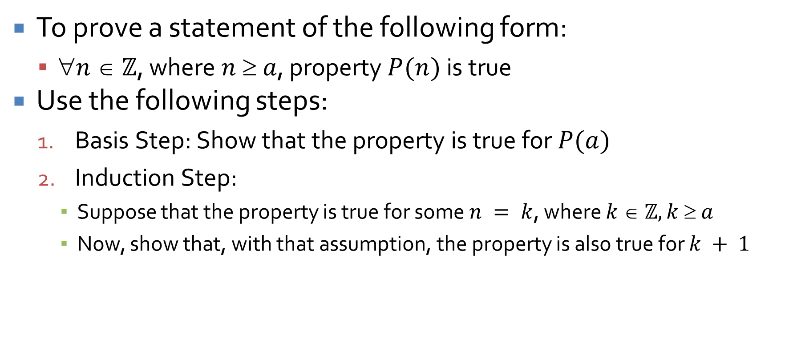
Proof by mathematical induction
To prove a statement of the following form:
  $n  ℤ$, where $n  a$, property $P(n)$ is true
Use the following steps:
  Basis Step: Show that the property is true for $P(a)$
  Induction Step:
    Suppose that the property is true for some $n = k$, where $k  ℤ, k  a$
    Now, show that, with that assumption, the property is also true for $k + 1$

Slide 8

Divisibility
Prove that, for all integers $n ≥ 1, 2^{2n}−1$ is divisible by $3$
Hint: Use induction

Slide 9

Inequality
Prove that, for all integers $n ≥ 3$, $2n + 1 < 2n$
Hint: Use induction

Slide 10
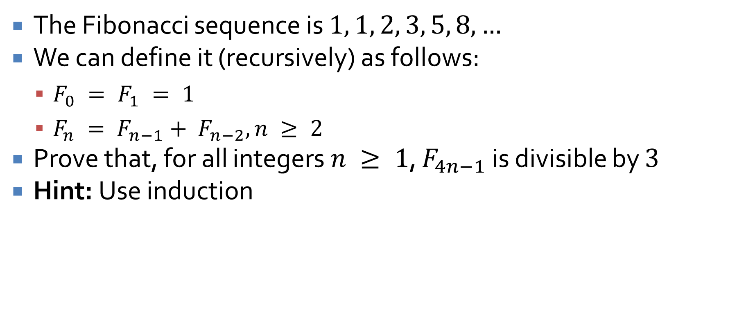
Fibonacci
The Fibonacci sequence is $1, 1, 2, 3, 5, 8, …$
We can define it (recursively) as follows:
  $F_{0} = F_{1} = 1$
  $F_{n} = F_{n−1}+ F_{n−2}, n ≥ 2$
Prove that, for all integers $n ≥ 1$, $F_{4n−1}$ is divisible by $3$
Hint: Use induction

Slide 11
Strong Induction

Slide 12
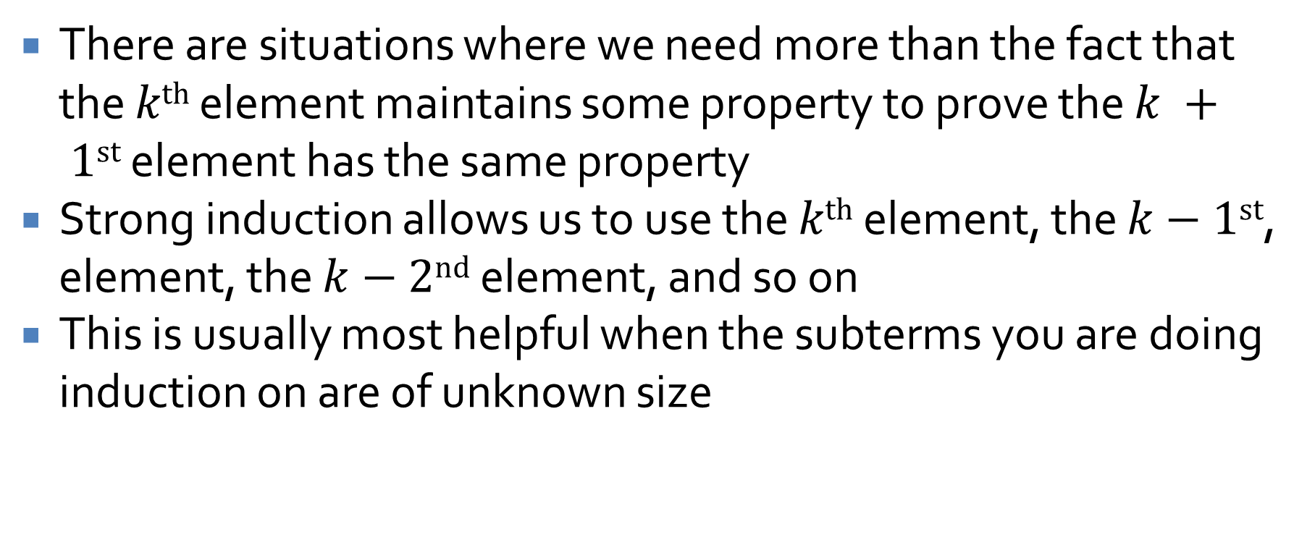
Strong induction
There are situations where we need more than the fact that the $kth$ element maintains some property to prove the $k + 1st$ element has the same property
Strong induction allows us to use the $kth$ element, the $k−1st$, element, the $k−2nd$ element, and so on
This is usually most helpful when the subterms you are doing induction on are of unknown size

Slide 13
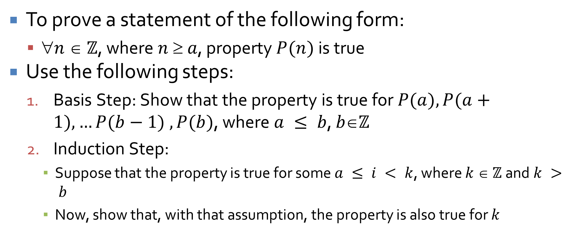
Proof by strong induction
To prove a statement of the following form:
  $n  ℤ$, where $n  a$, property $P(n)$ is true
Use the following steps:
  Basis Step: Show that the property is true for $P(a), P(a+1), …P(b−1) , P(b)$, where $a ≤ b$, $bℤ$
  Induction Step:
    Suppose that the property is true for some $a ≤ i < k$, where $k  ℤ$ and $k > b$
    Now, show that, with that assumption, the property is also true for $k$

Slide 14
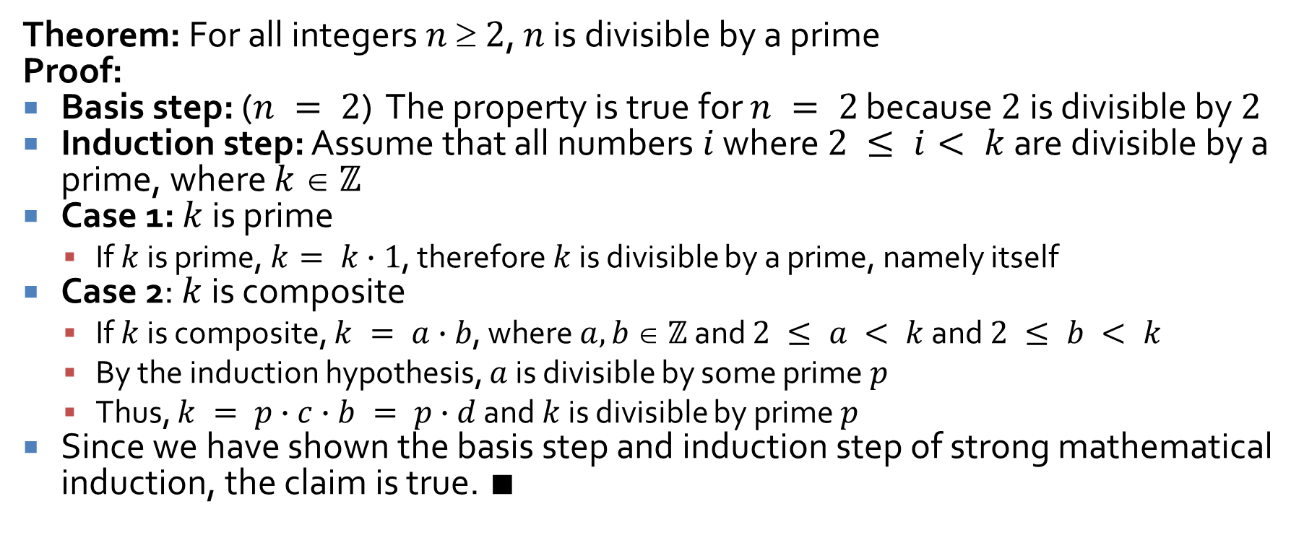
Example
Theorem: For all integers $n  2$, $n$ is divisible by a prime
Proof:
Basis step: ($n = 2$) The property is true for $n = 2$ because $2$ is divisible by $2$
Induction step: Assume that all numbers $i$ where $2 ≤ i< k$ are divisible by a prime, where $k  ℤ$
Case 1: $k$ is prime
  If $k$ is prime, $k= k∙1$, therefore $k$ is divisible by a prime, namely itself
Case 2: $k$ is composite
  If $k$ is composite, $k = a∙b$, where $a,b  ℤ$ and $2 ≤ a < k$ and $2 ≤ b < k$
  By the induction hypothesis, $a$ is divisible by some prime $p$
  Thus, $k = p∙c∙b = p∙d$ and $k$ is divisible by prime $p$
Since we have shown the basis step and induction step of strong mathematical induction, the claim is true. $∎$

Slide 15
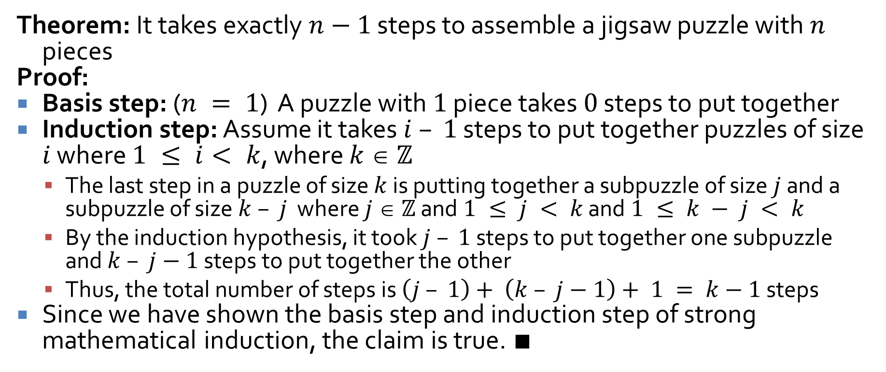
Example
Theorem: It takes exactly $n−1$ steps to assemble a jigsaw puzzle with $n$ pieces
Proof:
Basis step: ($n = 1$) A puzzle with $1$ piece takes $0$ steps to put together
Induction step: Assume it takes $i – 1$ steps to put together puzzles of size $i$ where $1 ≤ i< k$, where $k  ℤ$
  The last step in a puzzle of size $k$ is putting together a subpuzzle of size $j$ and a subpuzzle of size $k – j$ where $j  ℤ$ and $1 ≤ j < k$ and $1 ≤ k − j < k$
  By the induction hypothesis, it took $j – 1$ steps to put together one subpuzzle and $k – j−1$ steps to put together the other
  Thus, the total number of steps is $\left(j – 1\right)+ \left(k – j−1\right)+ 1 = k−1$ steps
Since we have shown the basis step and induction step of strong mathematical induction, the claim is true. $∎$

Slide 16
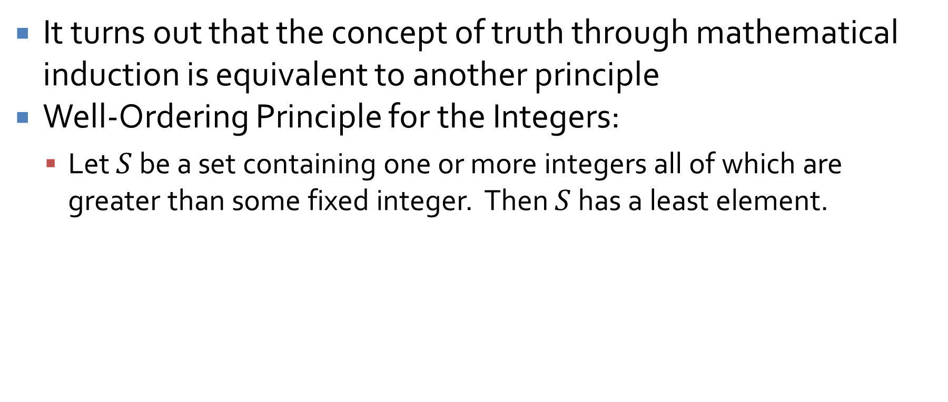
Well-Ordering Principle for Integers
It turns out that the concept of truth through mathematical induction is equivalent to another principle
Well-Ordering Principle for the Integers:
  Let $S$ be a set containing one or more integers all of which are greater than some fixed integer. Then $S$ has a least element.

Slide 17
Upcoming

Slide 18
Next time…
Second order linear homogeneous recurrence relations
General recursion

Slide 19
Reminders
Keep working on Assignment 2
Read 5.6, 5.7, 5.8, and 5.9

